Slide 1

RENT A BOOK
BookTheBooks(BTB)
SHAILY GUPTA- 23107085
VISHAL GUPTA- 23107139
SAKSHI JADHAV-23107110
MAYUR GOSAVI-23107092
Project Guide
Ms. AAVANI NAIR

Slide 2
Contents
Introduction
Objectives
Scope
Features / Functionality
Project Outcomes
Technology Stack
Block Diagram

Slide 3
1. Introduction
This is a online Rental System aims to provide a user-friendly platform where students and book lovers can rent books conveniently.
Problem identified:
Access to Books: Many readers cannot afford to buy every book they want to read.
Inconvenience: Traditional libraries and bookstores have limited hours of operation, and readers must physically visit to borrow or purchase books.
Space and Inventory: Physical libraries and bookstores have limited storage space

Slide 4
Solution Proposed :
An online rental system provides affordable access to a wide range of books without the need for purchase.
An online platform allows users to browse, rent, and return books from the comfort of their homes, anytime.
A rental system allows for a more dynamic management of inventory, with users borrowing and returning books more frequently, reducing the need for large physical collections
Cost-Efficiency: For book providers, a rental system allows them to generate recurring revenue from a single book by renting it multiple times instead of selling it just once. This maximizes the value of their inventory.

Slide 5
2. Objectives
To rent a book based on title and author.
To create a application that serves as a central book store at convenient and affordable price to integrate payment processing.
To provide a platform where user or customer can also give books on rent or sell, using mysql database to store customers and customer's book details.
To help users to search and filter to interact with database.

Slide 6
3. Scope
Can be useful to Educational Institutions like Schools, colleges, and universities, they can use book rental systems to provide students with textbooks or academic materials.
Bookstores or Retailers can offer book rental services for people who want to rent books instead of buying them, especially for expensive or rare titles.
Can be use as Corporate libraries, companies with large employee bases can use online book rental systems for internal knowledge-sharing and training materials.

Slide 7
4. Feature /Functionality
An online book rental system allows users to browse and rent books digitally, with secure user registration
User can easily search and filter books, can access rental history tracking, and payment processing for rental fees.
It includes functionalities for managing rental periods, overdue returns, and providing recommendations based on user preferences.

Slide 8
5. Outcome of Project
Users can easily browse and rent books from anywhere, anytime, without visiting physical libraries or stores.
Cost Savings Renting books reduces the need for purchasing, offering a budget-friendly solution, especially for expensive or one-time-use books.
Also having Environmental Impact, promotes sustainability by reducing paper waste and encouraging use of ebooks.

Slide 9
6. Technology Stack
1.IDE: NetBeans Integrated development environment (IDE) used for developing Java applications. Provides features like code editing, debugging, and project management.
2.Database: MySQL Open-source relational database management system (RDBMS).MySQL Workbench for database design, querying, and management. MySQL Connector/J: The official JDBC driver for connecting Java applications to MySQL databases.

Slide 10
3.For Payment:
Frontend: Java Swing: For creating a graphical user interface (GUI) for the payment section. Both libraries are supported within the NetBeans IDE.
Backend: MySQL Schema for Payments:
User Table: Stores user information (user_id, name, email, etc.).
Payment Table: Stores payment transactions (payment_id, user_id, amount, payment_method, status, etc.).
Transaction History Table: Keeps a log of all payment transactions.

Slide 11
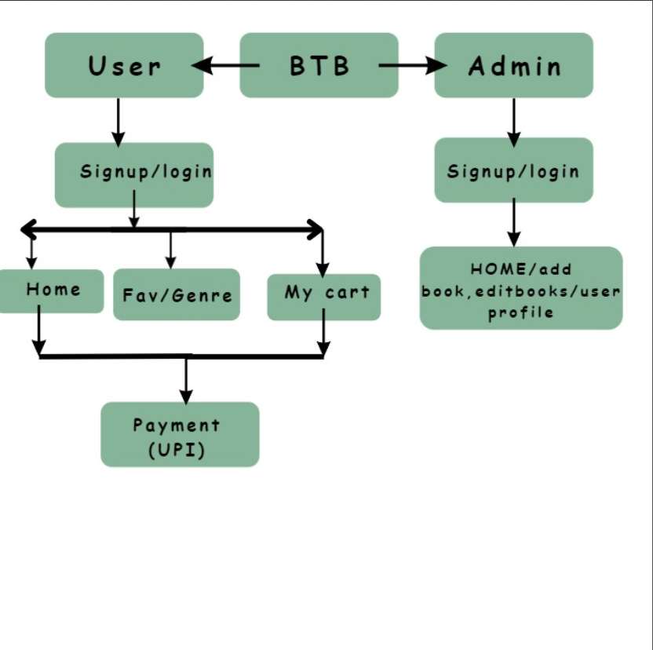
7. Block Diagram

Slide 12
Thank You...!!

